Slide 1
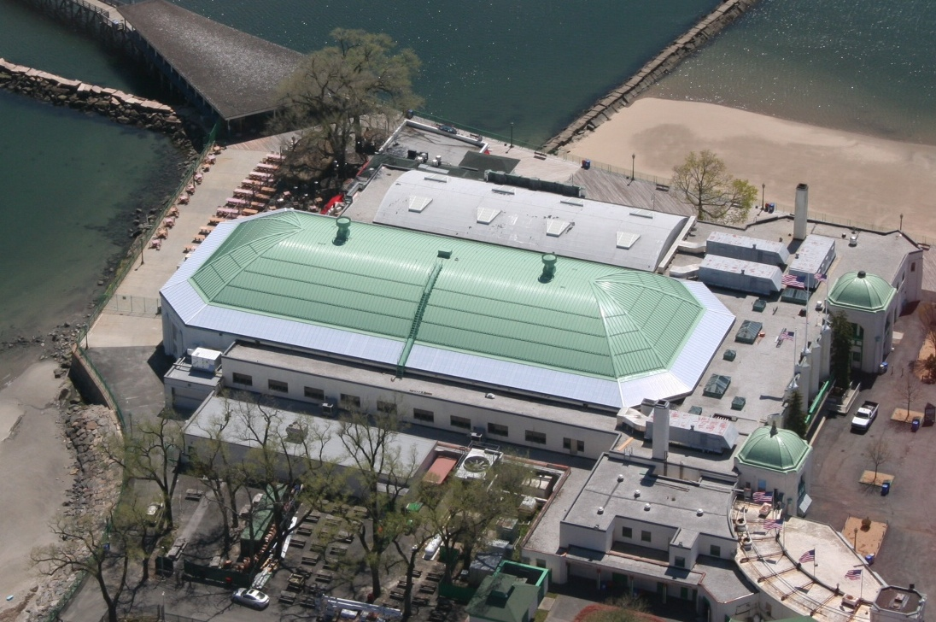
Playland Ice Casino, Rye, New York
Horizon Polycarbonate System

Slide 2
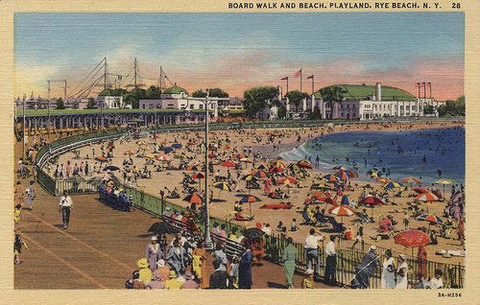
CHALLENGE:
As part of the Hurricane Sandy reconstruction efforts, the historic casino’s wooden shingle roof needed replacement.
Old rubberized fabric perimeter which was not energy efficient and provided little natural daylight.
Limited restoration budget.

Slide 3
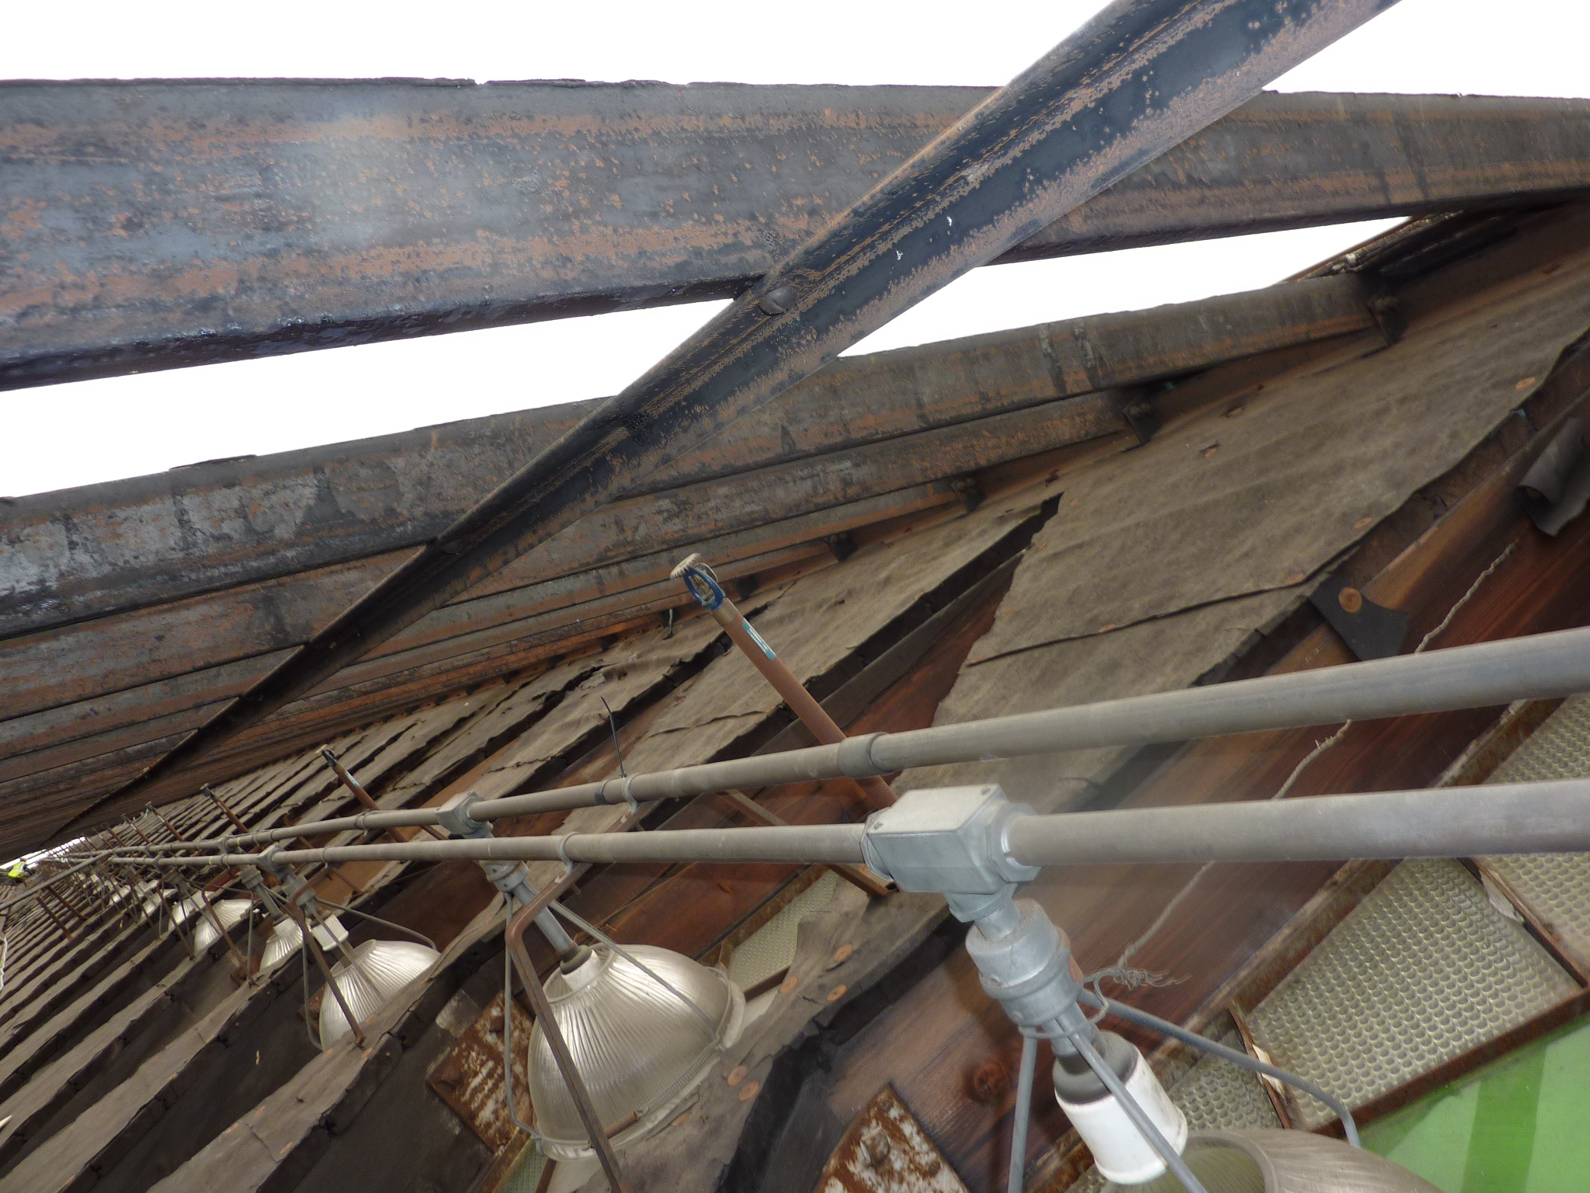
The historic casino’s old rubberized fabric perimeter and wooden shingle roof.

Slide 4
SOLUTION
Wasco's sales representative, Fontana Metal Sales Corp., presented the general contractor, MILCON Const. Corp. with an alternative option than originally specified - Wasco's Horizon Polycarbonate System.
Dry glazed, standing seam system with proven energy saving solar and thermal properties, constructed of lightweight, impact resistant, UV protected polycarbonate panels.

Slide 5
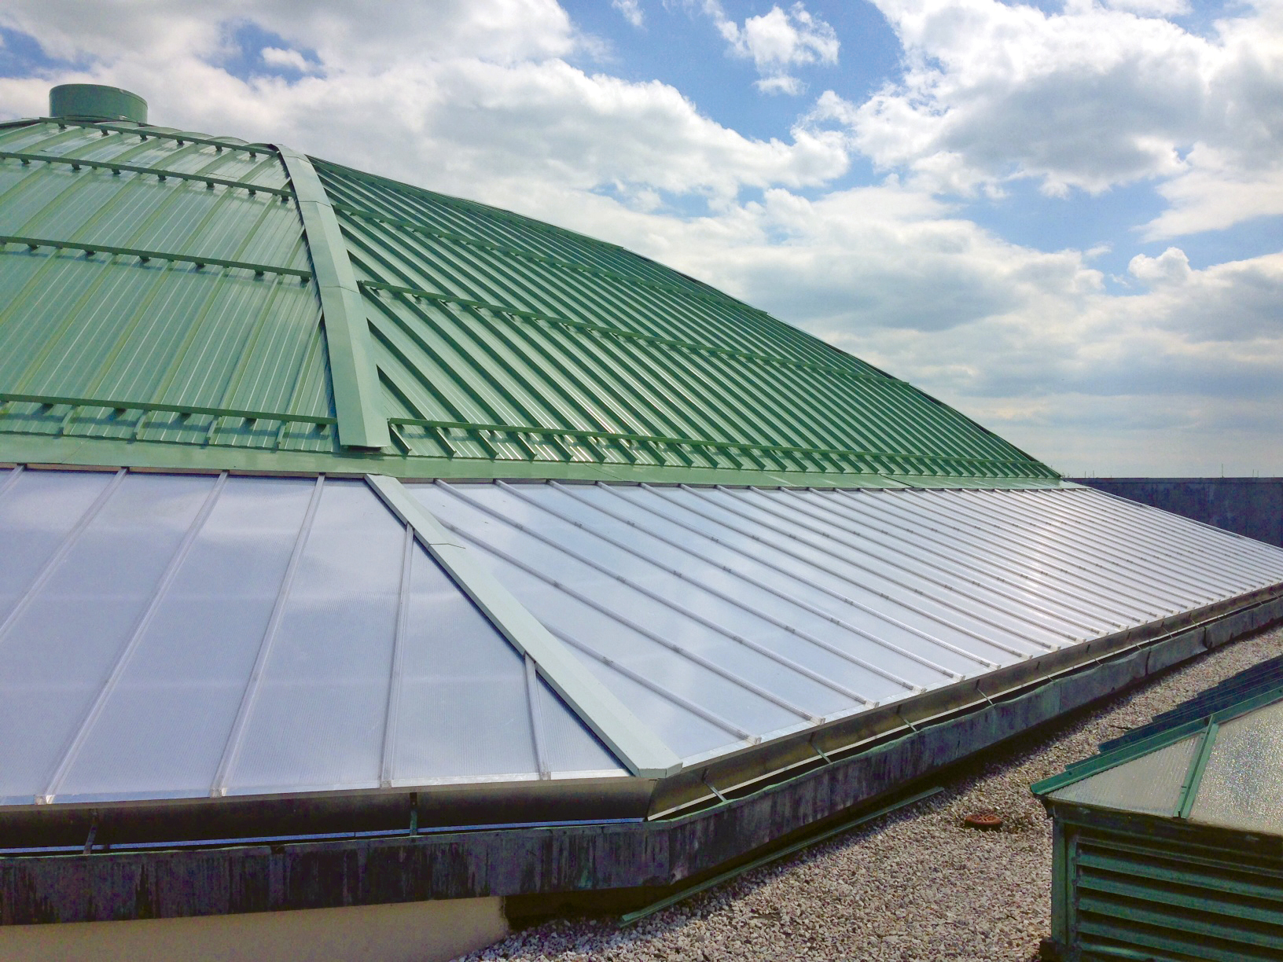

Slide 6
SOLUTION
30 to 40% savings in labor costs - quicker, simpler, installation using existing structure and supports to simply "skin" the structure.
10% reduction in material costs by using the existing structure and support system.
Provides greater natural daylight, transmitted through the interior diamond shaped window system.

Slide 7
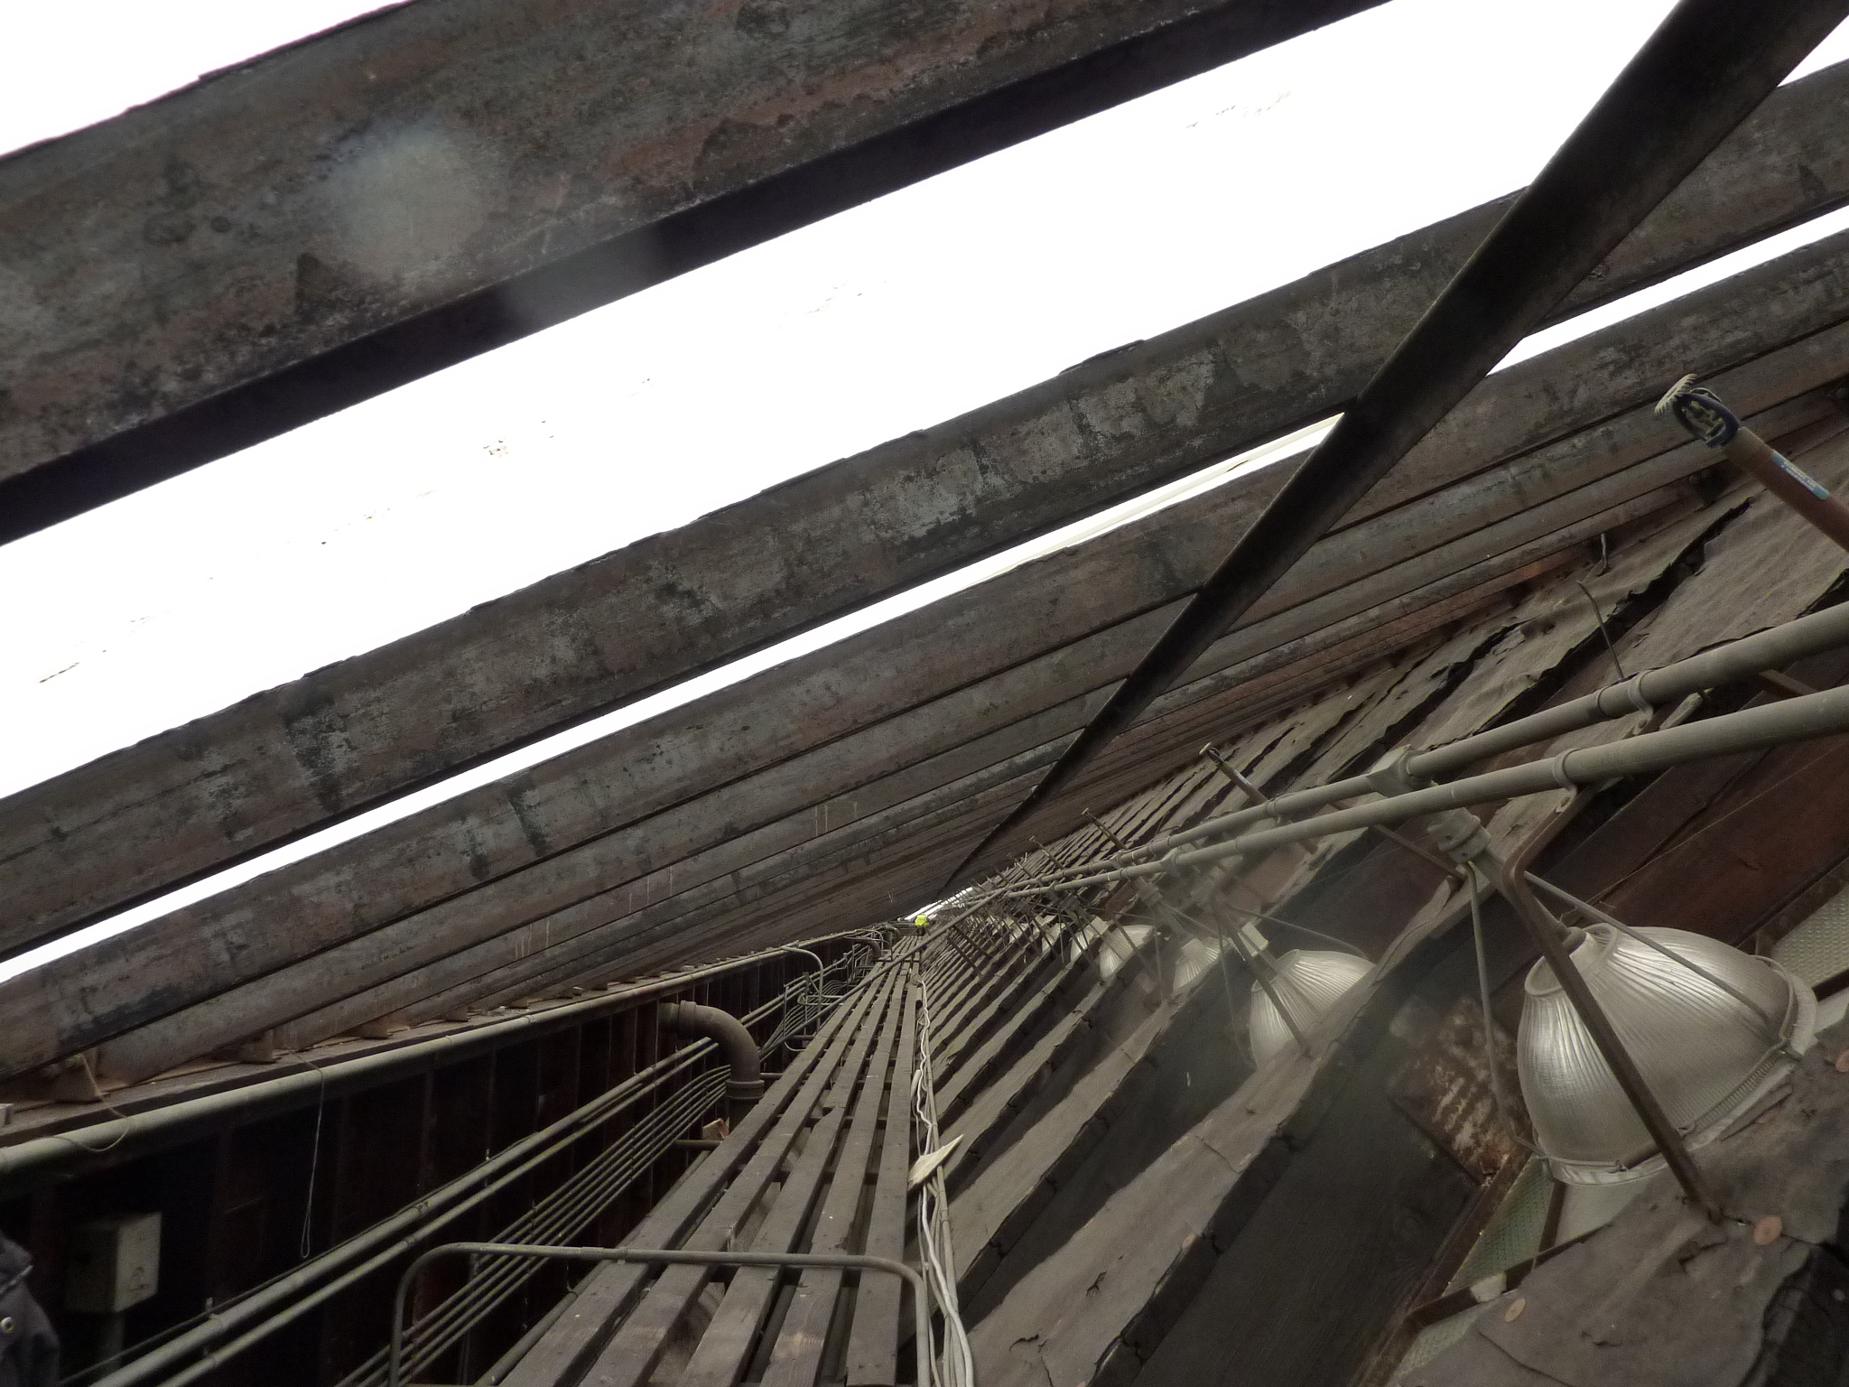
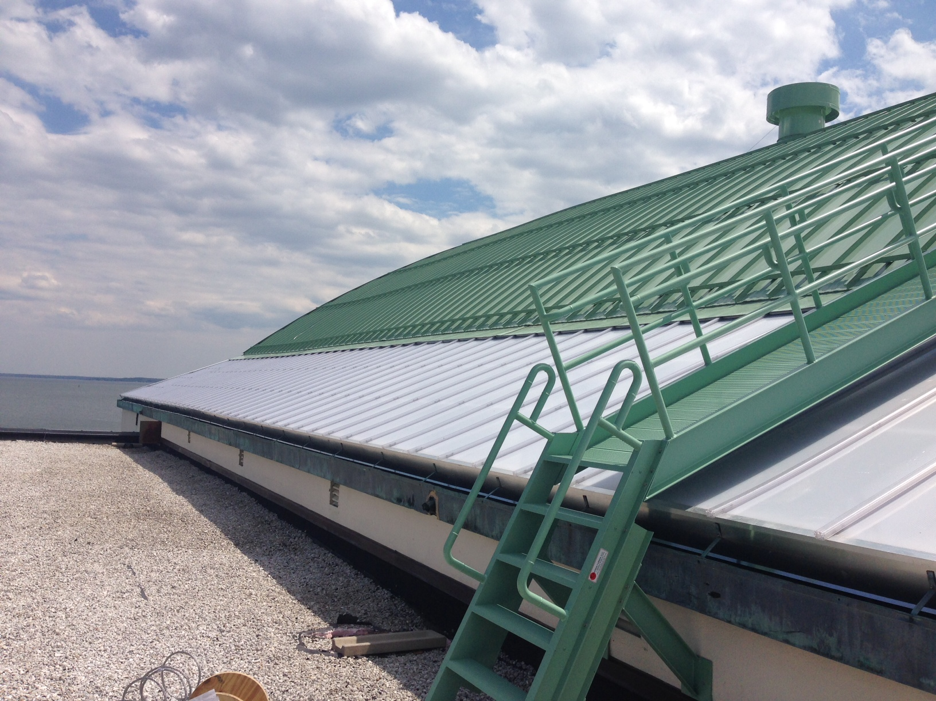
Quicker, simpler, installation using existing structure and supports to simply "skin" the structure.

Slide 8
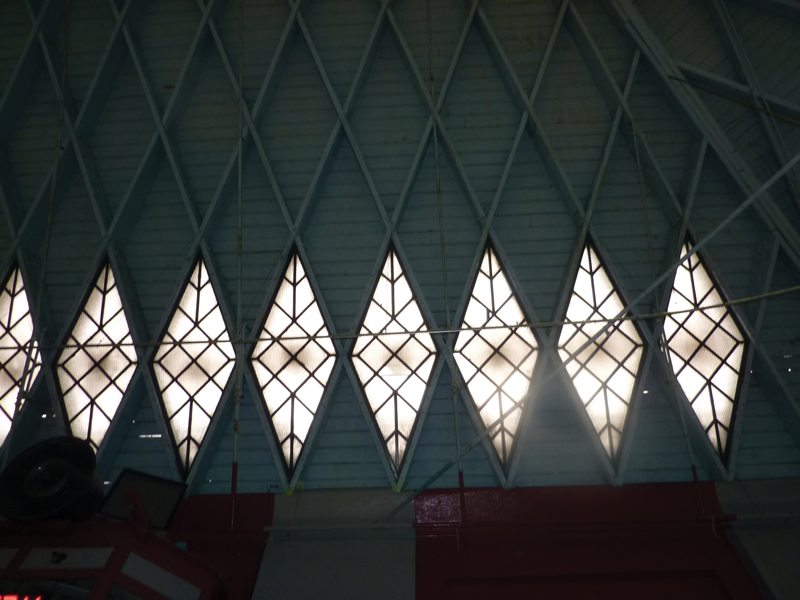
Natural daylight transmitted through the interior diamond shaped window system.

