Slide 1
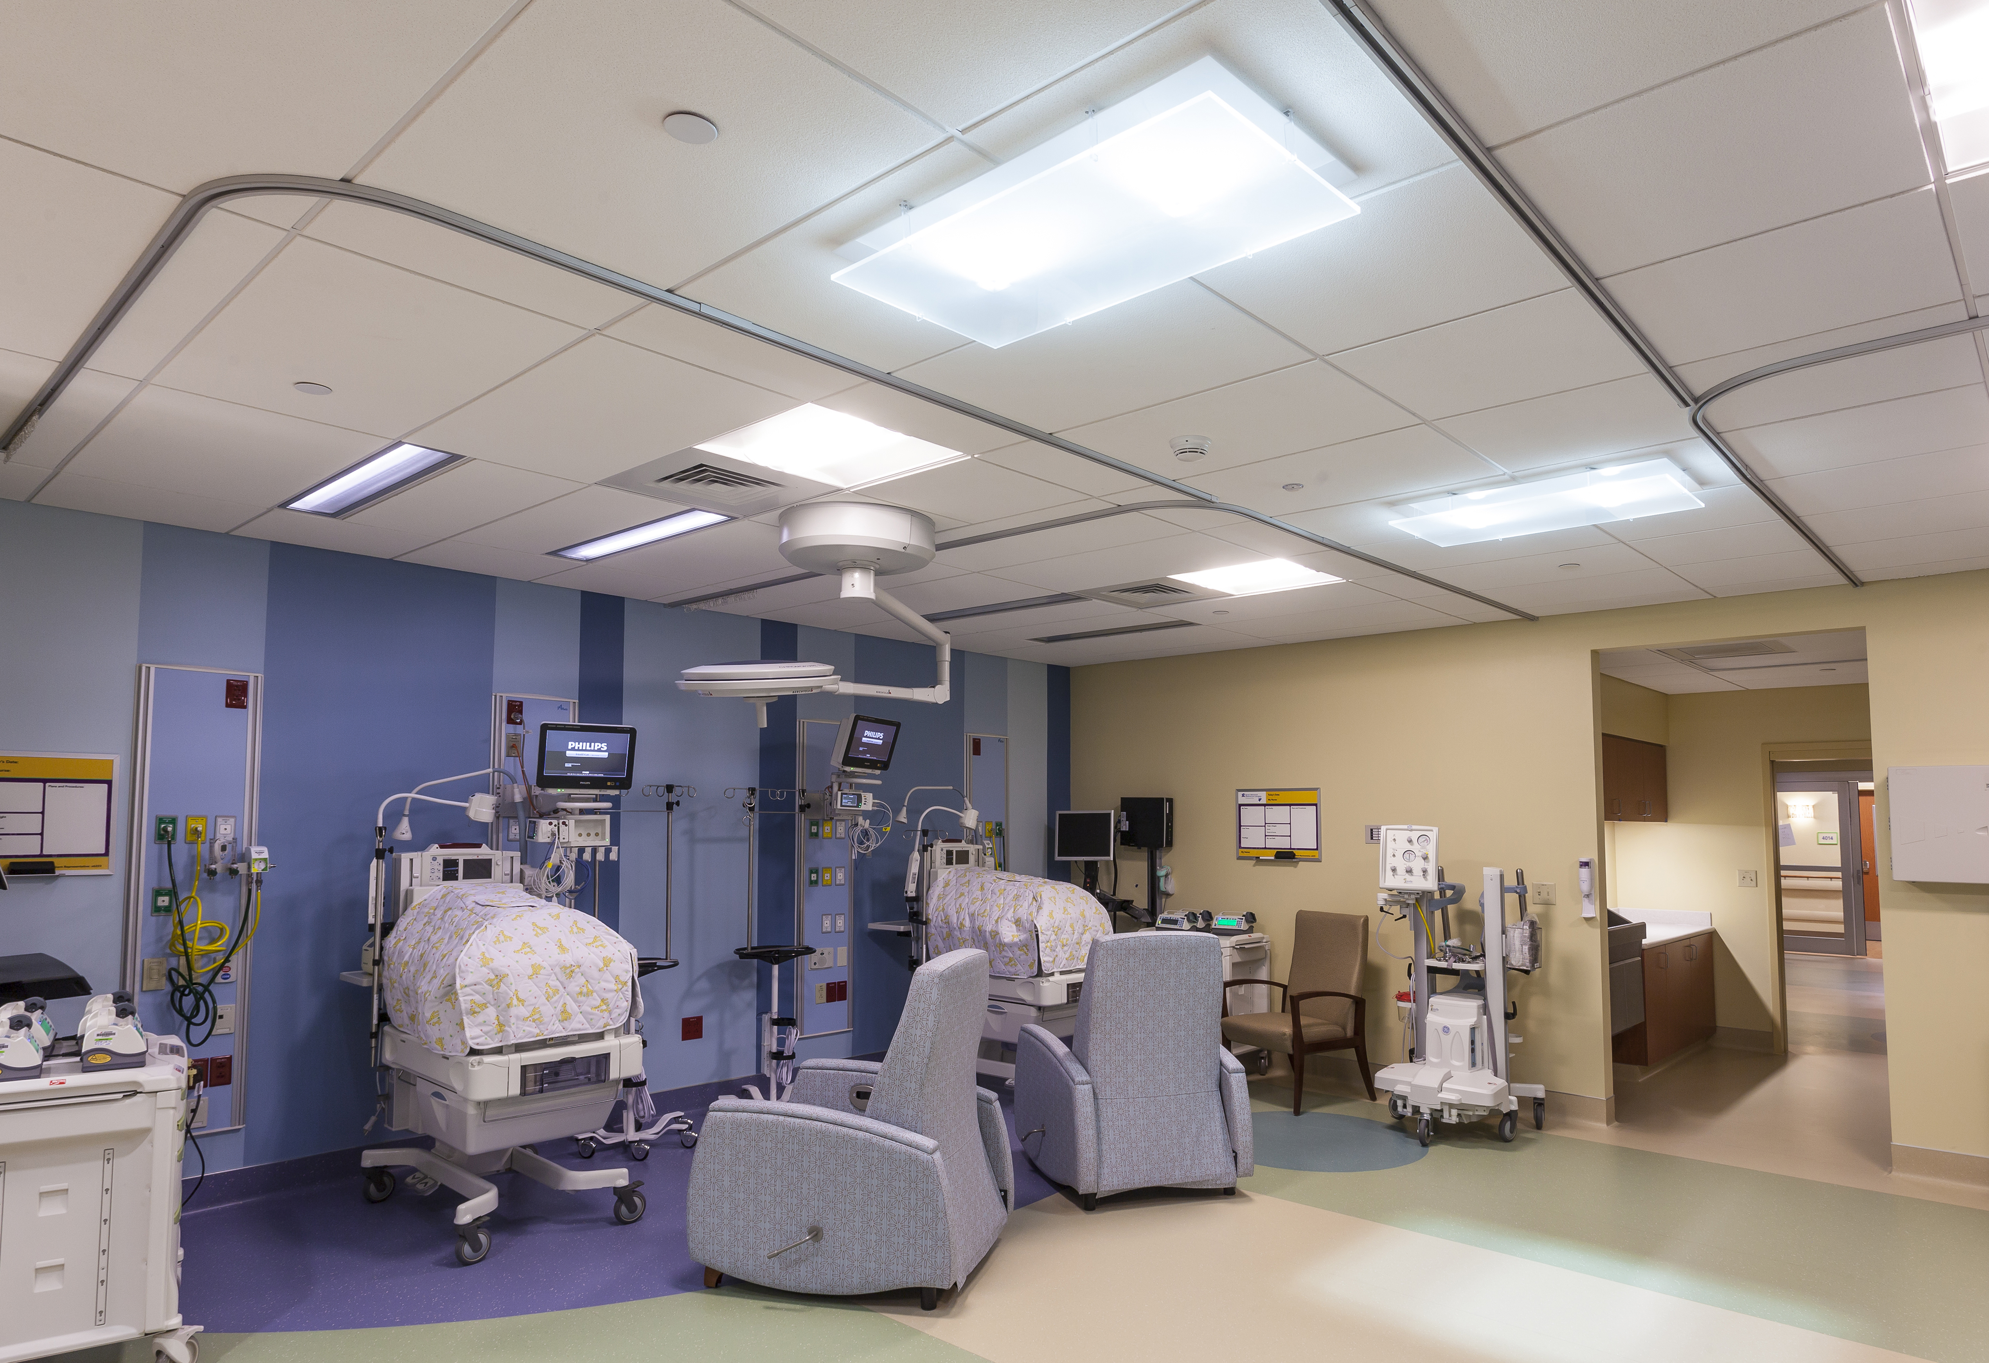
Presbyterian/St. Luke's Medical Center Denver, CO
Parans Solar Lighting System

Slide 2
CHALLENGE
Planned renovations in the Neonatal Unit was a great opportunity to incorporate natural daylight into this sensitive healthcare space.
Remodeling was cosmetic, so any daylighting solution could not require extensive construction
Heat gain a major factor in the Neonatal Unit, a critical care environment

Slide 3
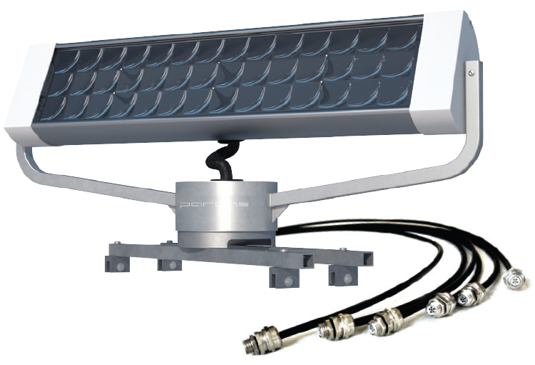
SOLUTION
The Parans Solar Lighting System was the perfect and only viable solution.
Two Parans receivers were placed on the roof, harvesting natural sunlight by continuously tracking the sun all day to transmit full-spectrum natural daylight through fiber optic cables to four Parans Solar Luminaires.

Slide 4
Delivers full-spectrum natural light with no heat gain or costly construction.

Slide 5
"Using no electricity, they created beautiful, healthy natural sunlight! I'm very happy with the results."
Darla Van Essen, Hospital Administrator
"It works exactly as advertised, delivering full-spectrum natural light where it's needed most, and with no heat gain or costly construction."
Vic Vigil, Maintenance Manager

